Slide 1

GROUP MEMBERS:-
Shahrukh Padaniya
Rohan Yadav
Swapnil Sevak
GROUP-6

Slide 2

Core-image-sato
core-image-sato

Slide 3
What is core-image-sato?
This image provides X11 support that includes the Opened Hand Sato user experience for mobile devices.
Besides the Sato screen manager, the image also provides several applications using the Sato theme.

Slide 4
Core-image-sato has following applications when we start-
terminal
editor
file manager
games
​media player
Calibrate touchscreen

Slide 5
How to run core-image-sato :-
1) First download poky and extract the file.
2) Go to poky and type following command-
cd poky
source oe-init-build-env
bitbake core-image-sato
3) To run "core-image-sato" on an emulator, we need to type following command-
runqemu qemux86
If it gives error, we can use runqemu qemux86 nographic

Slide 6
We can select following emulator machine by going to local.conf file and uncommenting the required machine.
#MACHINE ?= "qemuarm"
#MACHINE ?= "qemuarm64"
#MACHINE ?= "qemumips"
#MACHINE ?= "qemumips64"
#MACHINE ?= "qemuppc"
#MACHINE ?= "qemux86"
#MACHINE ?= "qemux86-64"
We can also select hardware board target machine.
#MACHINE ?= "beaglebone-yocto"
#MACHINE ?= "genericx86"
#MACHINE ?= "genericx86-64"
#MACHINE ?= "edgerouter"

Slide 7
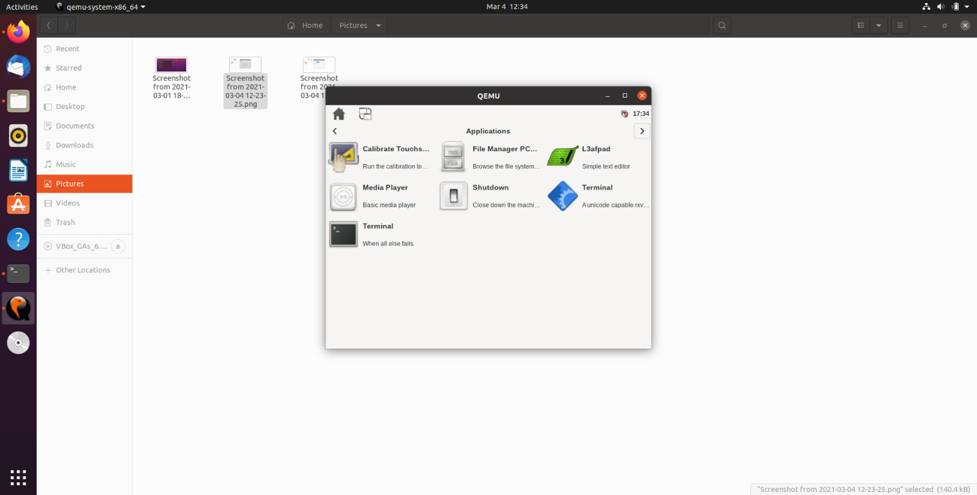
Applications in core-image-sato -

Slide 8
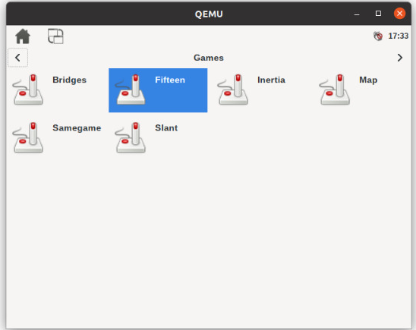
Different games available in core-image-sato -

Slide 9
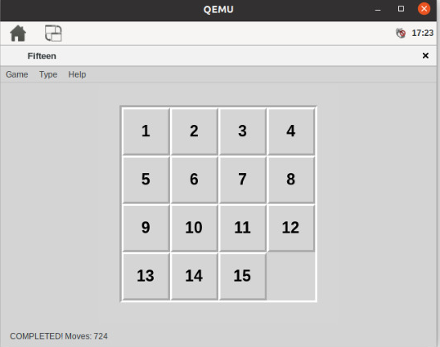
Playing game in QEMU

Slide 10
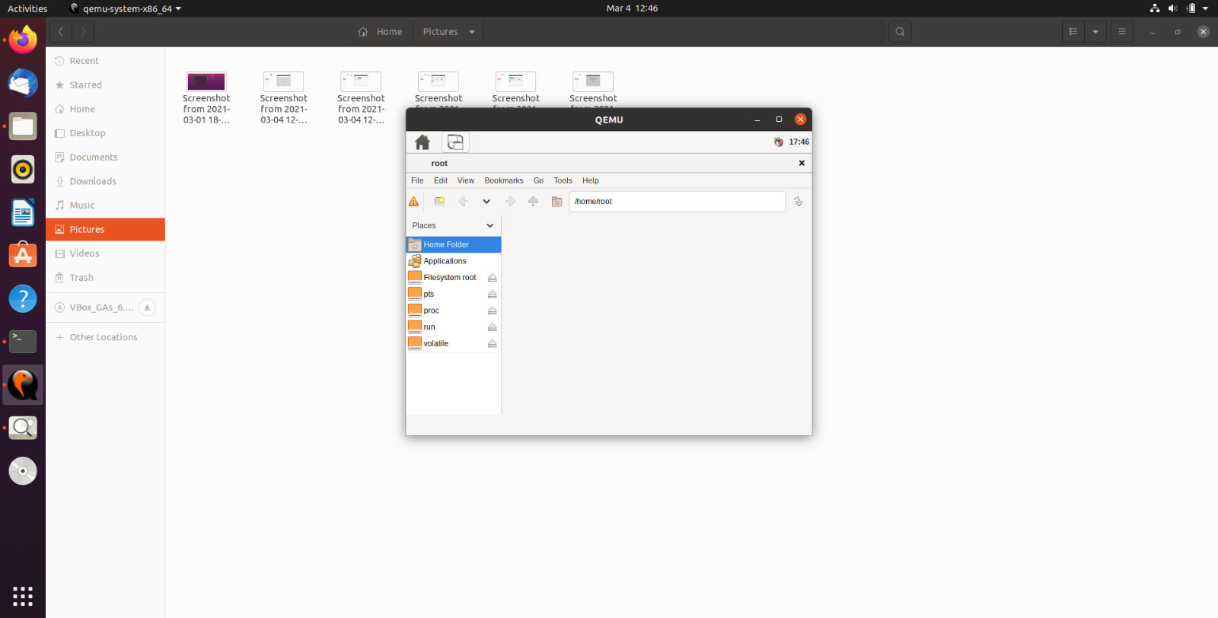
File manager in core-image-sato

Slide 11
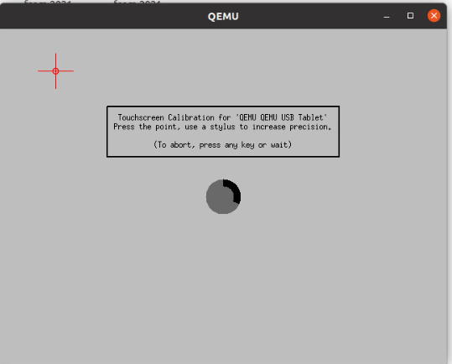
Calibrate touchscreen in core-image-sato

Slide 12
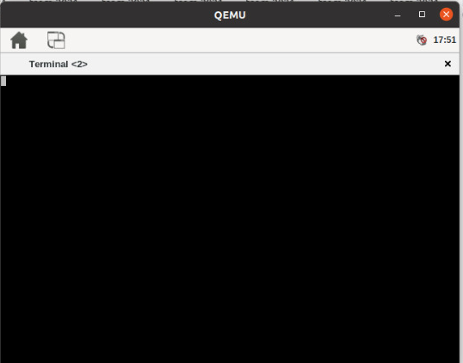
Terminal in core-image-sato

Slide 13
References:-
https://hacklabalmeria.net/recursos/2015-06-12/YPRealtrack.pdf

Slide 14
THANK YOU

Slide 15
THE END

